Slide 1
Eniac - Magist
Deal or No deal?
Let’s review the numbers to understand why this deal may not be a good decision.

Slide 2
Magist
Brazilian Software Service company that offers a centralized order management system to connect small and medium-sized stores with the biggest Brazilian marketplaces.
Magist provides after-sales services such as stock and warehouse management, product shipment, and customer service related to the shipment.

Slide 3
Magist is already a big player.
It has signed advantageous contracts with the marketplaces and with the Post Office, thus reducing the cost of fees and, most importantly, the bureaucracy involved in getting things started.
Eniac is considering signing a 3-year contract with Magist as an intermediate step, while it tests the market, creates brand awareness, and explores the option of setting up its own supply chain management.

Slide 4
However,what is important to know is,
Eniac is 100% tech company, and Magist sells only approximately 10% of tech products.
The question is;
Will Magist be a good representative for Eniac’s products?

Slide 5
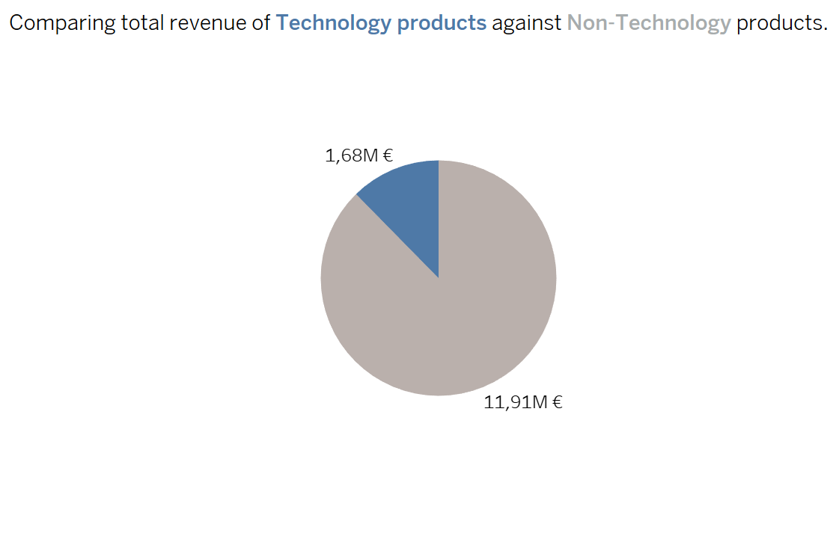
Revenue
Technology product revenue is not very high, only 12%.

Slide 6
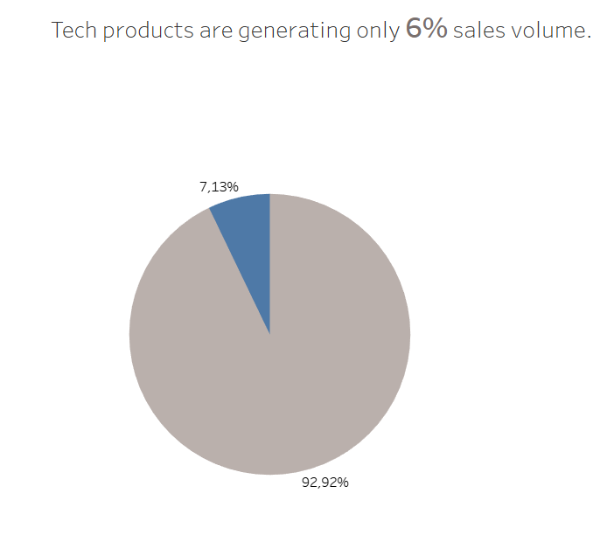
Sales volume of Tech products is a small piece of the pie

Slide 7
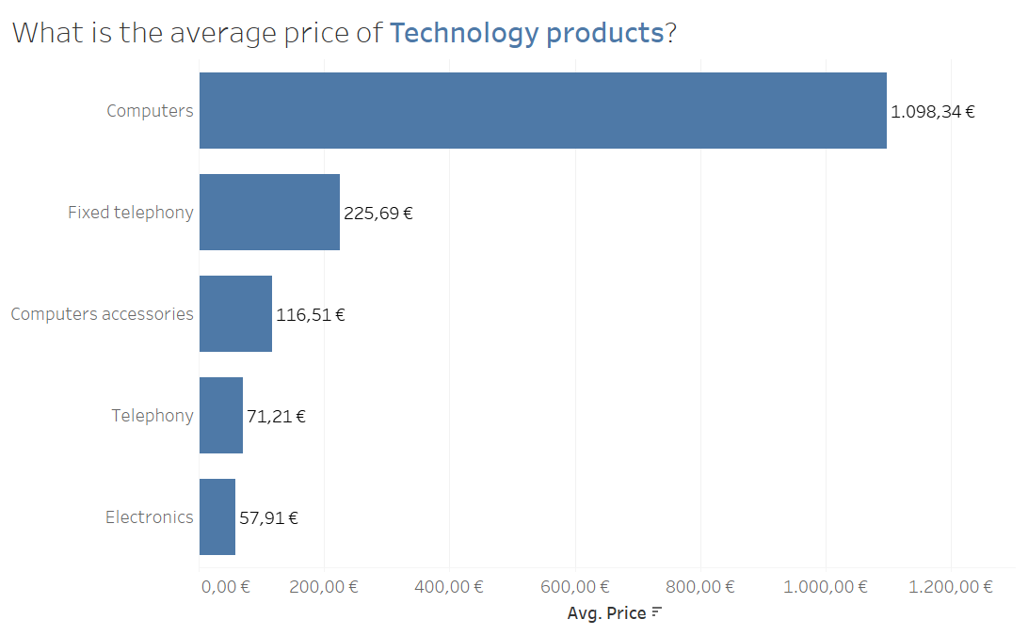
Technology product price list is a proof of different customer groups
As a new player on the market, Eniac must reduce the pricing by reducing the commission so the products become more competitive on the market.
Eniac’s price lists for Apple products will be significantly higher than the most of what Magist is selling, and he starting point is around 1500 €.
Price range for Magist Technology products is 57 - 225 €.
However, the computers stand out with the pricing over 1000€.

Slide 8
Average delivery time is 12 days
Sales of tech products are generally low each year, except for a notable increase in 2018 compared to non-tech products

Slide 9
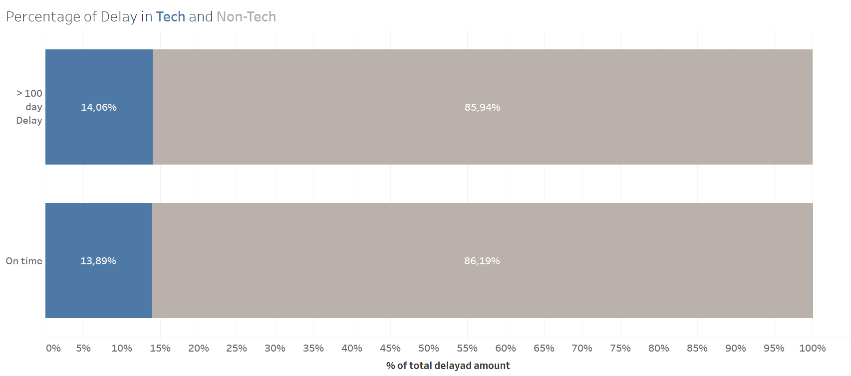
Another argument on how small Tech product sales are in overall is a small percentage of delivery delay for Tech products, of only 13-14%
.

Slide 10
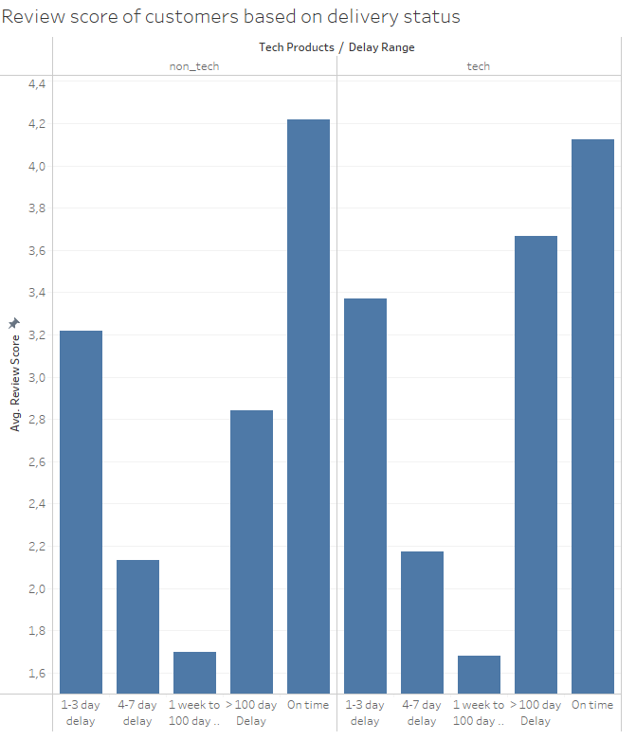
Customers are happy with products and services
Review score is highest for on-time delivery status of tech and non-tech products. Tech products have good reviews comparing of non-tech
Overall average review score of tech products is 3.9 and ontime score is 4.1 impressive.

Slide 11
Signing a contract with a big distributor or a multinational company has its challenges,
Our advice would be not to sign the deal with Magist.
They lack sufficient experience in high-end tech sales to effectively represent our products
Considering the Data for Technology products
6% of sales volume
12% of sale profit
12 days delivery time

Slide 12
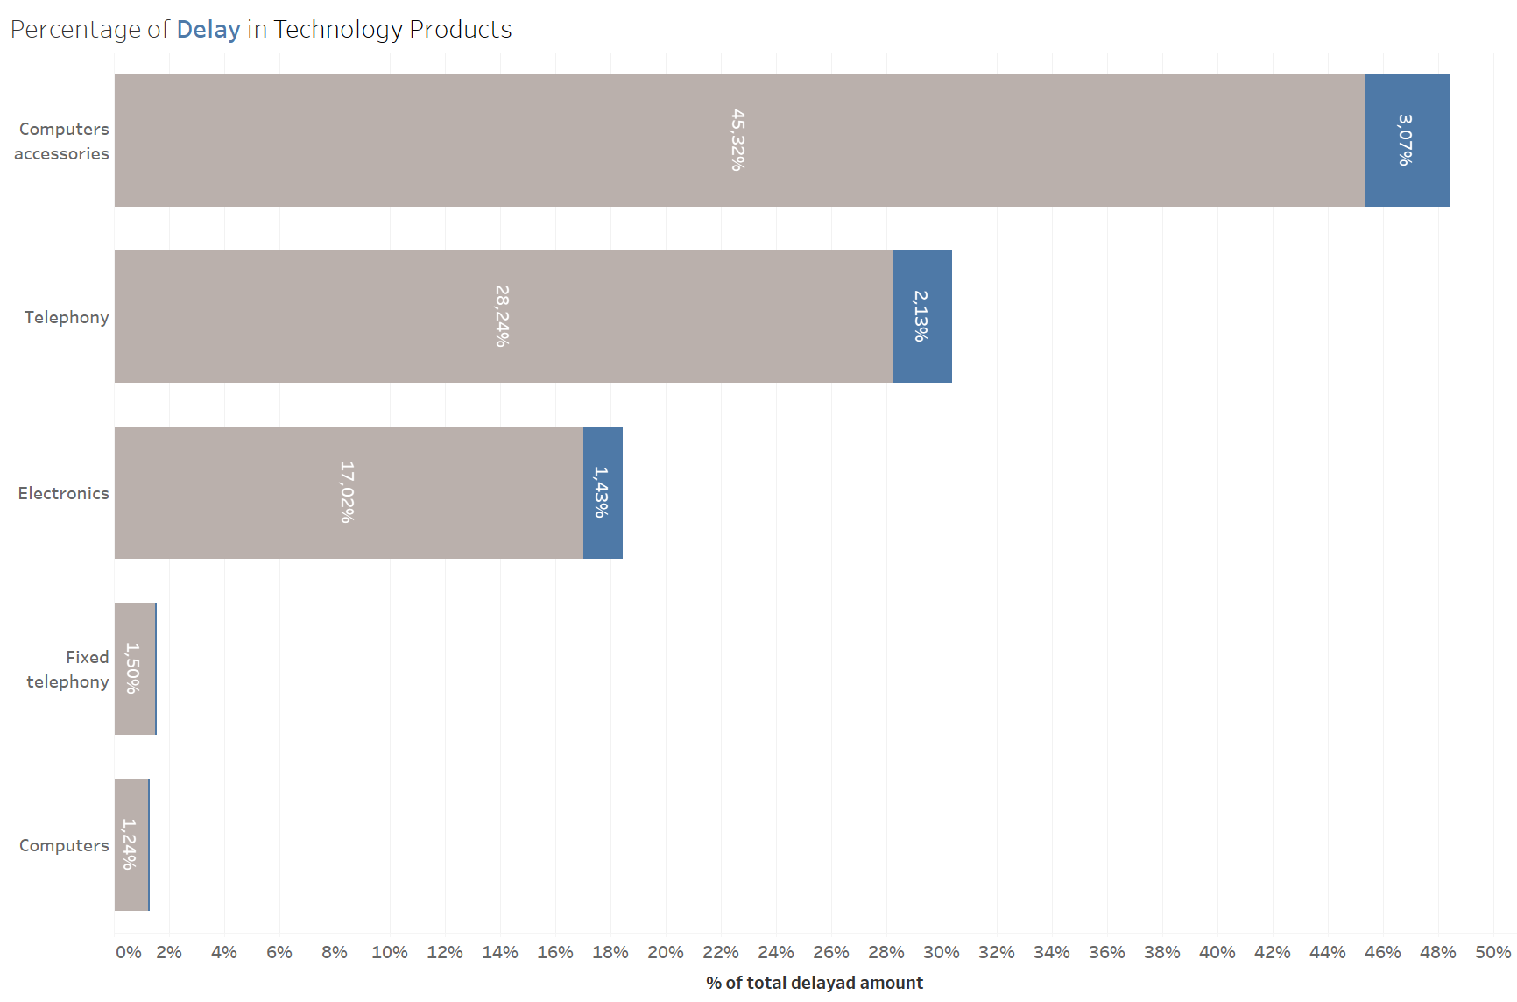
APPENDIX- extra charts, just in case we get a question

Slide 13
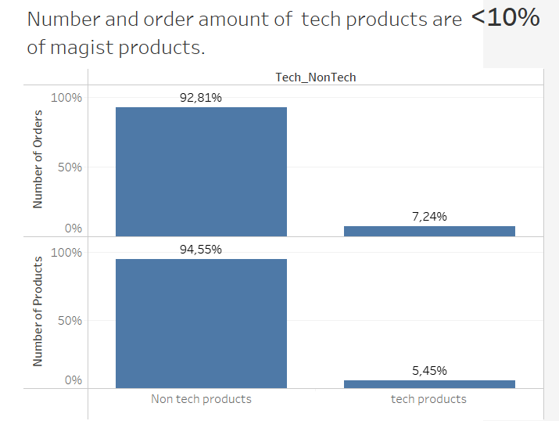

Slide 14

% of delayed Tech products

Slide 15
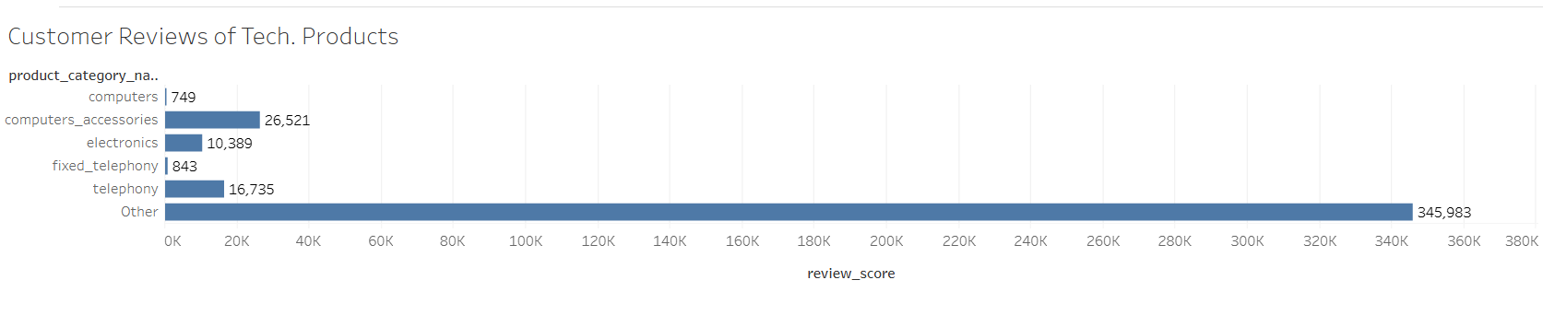
Reviews of Tech in overall

Slide 16
